Slide 1
Chapter 4
The Building Blocks: Binary Numbers, Boolean Logic, and Gates

Slide 2
Learning Objectives (1 of 2)
Translate between base-ten and base-two numbers, and represent negative numbers using both sign-magnitude and two’s complement representations
Explain how fractional numbers, characters, sounds, and images are represented inside the computer
Build truth tables for Boolean expressions and determine when they are true or false
Describe the relationship between Boolean logic and electronic gates

Slide 3
Learning Objectives (2 of 2)
Construct circuits using the sum-of-products circuit design algorithm, and analyze simple circuits to determine their truth tables
Explain how large, complex circuits, like 32-bit adder or compare-for-equality circuits, are constructed from simpler, 1-bit components
Describe the purpose and workings of multiplexer and decoder control circuits

Slide 4
Introduction
This chapter introduces the fundamental building blocks of all computer systems
Binary representation
Boolean logic
Gates
Circuits
This chapter examines what the computing agent looks like and how it is able to execute instructions and produce results

Slide 5
The Binary Numbering System (1 of 21)
How can an electronic (or magnetic) machine represent information?
Key requirements: clear, unambiguous, and reliable
External representation is human-oriented
Base-10 numbers
Keyboard characters
Internal representation is computer-oriented
Base-2 numbers
Base-2 codes for characters

Slide 6
The Binary Numbering System (2 of 21)
Binary is the simple idea of On/Off, Yes/No, True/False, and Positive/Negative.
Binary is important to computing systems because of it’s stability and reliability.
Even when an electrical system degrades, there is still a clear “On/Off.”
All data stored inside a computer is stored in binary (also called machine language) and interpreted to display on the screen in human language.

Slide 7
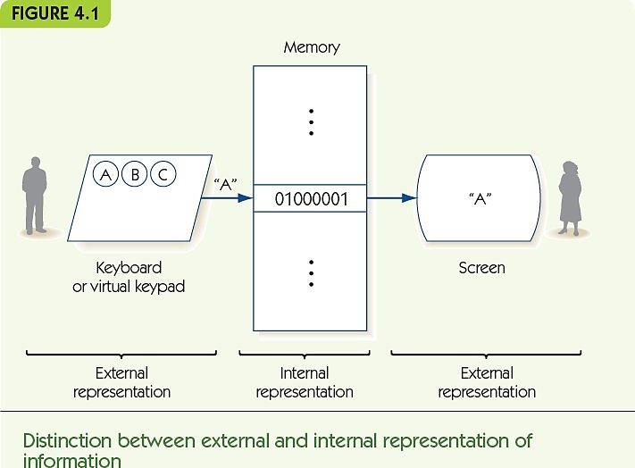
The Binary Numbering System (3 of 21)

Slide 8
The Binary Numbering System (4 of 21)
The binary numbering system is a base-2 positional numbering system
Base ten:
Uses 10 digits: 0, 1, 2, 3, 4, 5, 6, 7, 8, and 9
Each place corresponds to a power of 10
1,943 = (1 × 10³) + (9 × 10²) + (4 × 10¹) + (3 × 10⁰)
Base two:
Uses 2 digits: 0 and 1
Each place corresponds to a power of 2
1101 = (1 × 2³) + (1 × 2²) + (0 × 2¹) + (1 × 2⁰) = 13

Slide 9
The Binary Numbering System (5 of 21)
FIGURE 4.2 Binary-to-decimal conversion table
Binary | Decimal
0 | 0
1 | 1
10 | 2
11 | 3
100 | 4
101 | 5
110 | 6
111 | 7
1000 | 8
1001 | 9
1010 | 10
1011 | 11
1100 | 12
1101 | 13
1110 | 14
1111 | 15
Binary | Decimal
10000 | 16
10001 | 17
10010 | 18
10011 | 19
10100 | 20
10101 | 21
10110 | 22
10111 | 23
11000 | 24
11001 | 25
11010 | 26
11011 | 27
11100 | 28
11101 | 29
11110 | 30
11111 | 31

Slide 10
The Binary Numbering System (6 of 21)
Converting from binary to decimal
Add up powers of two where a 1 appears in the binary number
Converting from decimal to binary
Repeatedly divide by two and record the remainder
Example, convert 11:
11 ÷ 2 = 5, remainder = 1, binary number = 1
5 ÷ 2 = 2, remainder = 1, binary number = 11
2 ÷ 2 = 1, remainder = 0, binary number = 011
1 ÷ 2 = 0, remainder = 1, binary number = 1011

Slide 11
The Binary Numbering System (7 of 21)
Computers use fixed-length binary numbers for integers, e.g., 4 bits could represent 0 to 15
Arithmetic overflow: when the computer tries to make a number that is too large, e.g., 14 + 2 with 4 bits
Binary addition: 0 + 0 = 0, 0 + 1 = 1, 1 + 0 = 1,
1 + 1 = 10 (that is, 0 with a carry of 1)
Example: 0101 + 0011 = 1000

Slide 12
The Binary Numbering System (8 of 21)
Signed integers include negative numbers
Sign/magnitude notation uses 1 bit for the sign and the rest for the value
+5 = 0101, -5 = 1101
0 = 0000 and 1000!
Two’s complement representation: to make the negative of a number, flip every bit and add one
+5 = 0101, -5 = 1010 + 1 = 1011
0 = 0000, -0 = 1111 + 1 = 0000

Slide 13
The Binary Numbering System (9 of 21)
Floating point numbers use binary scientific notation
Scientific notation, base 10: 1.35 × 10⁻⁵
Base 2: 3.25₁₀ = 11.01₂ = 1.101 × 2¹
Characters and text: map characters onto binary numbers in a standard way
ASCII (8-bit numbers for each character)
Unicode (Minimum of 16-bit numbers for each character)

Slide 14
The Binary Numbering System (10 of 21)
Sounds and images require converting naturally analog representations to digital representations
Sound waves characterized by:
Amplitude: height of the wave at a moment in time
Period: length of time until wave pattern repeats
Frequency: number of cycles per unit time

Slide 15
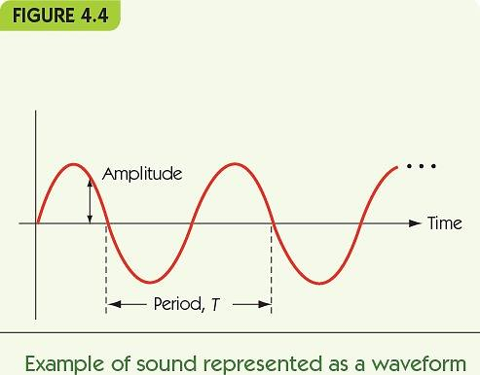
The Binary Numbering System (11 of 21)

Slide 16
The Binary Numbering System (12 of 21)
Digitize: to convert to a digital form
Sampling: record sound wave values at fixed, discrete intervals
To reproduce sound, approximate using samples
Quality is determined by
Sampling rate: number of samples per second
More samples ► more accurate waveform
Bit depth: number of bits per sample
More bits ► more accurate amplitude

Slide 17
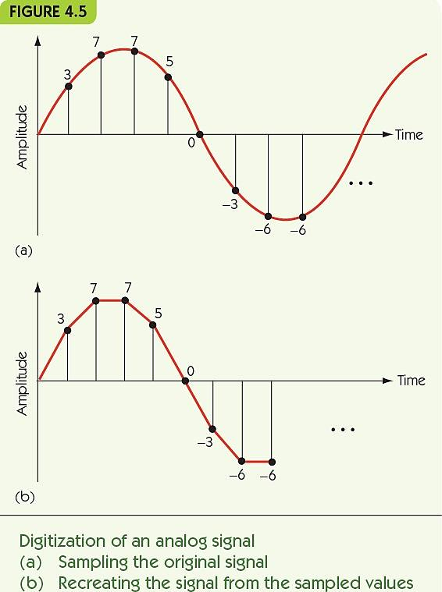
The Binary Numbering System (13 of 21)

Slide 18
The Binary Numbering System (14 of 21)
Image sampling: record color or intensity at fixed, discrete intervals in two dimensions
Pixels: individual recorded samples
RGB encoding scheme:
Colors are combinations of red, green, and blue
One byte each for red, green, and blue
Raster graphics store picture as two dimensional grid of pixel values

Slide 19
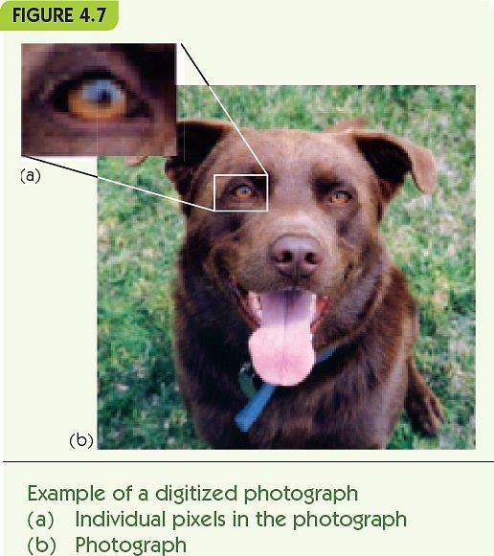
The Binary Numbering System (15 of 21)

Slide 20
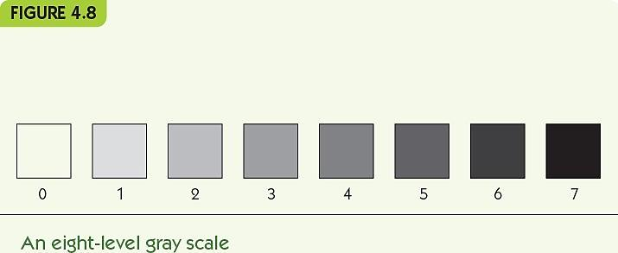
The Binary Numbering System (16 of 21)

Slide 21
The Binary Numbering System (17 of 21)
What is the space necessary to store the following data?
1000 integer values
10-page text paper
60-second sound file
480 by 640 image
Data compression: storing data in a reduced-size form to save space/time
Lossless: data can be perfectly restored
Lossy: data cannot be perfectly restored

Slide 22
The Binary Numbering System (18 of 21)
Letter | 4-bit Encoding | Variable Length Encoding
A | 0000 | 00
I | 0001 | 10
H | 0010 | 010
W | 0011 | 110
E | 0100 | 0110
O | 0101 | 0111
M | 0110 | 11100
K | 0111 | 11101
U | 1000 | 11110
N | 1001 | 111110
P | 1010 | 1111110
L | 1011 | 1111111
 | (a) | (b)
Using variable-length code sets
Fixed Length
Variable Length

Slide 23
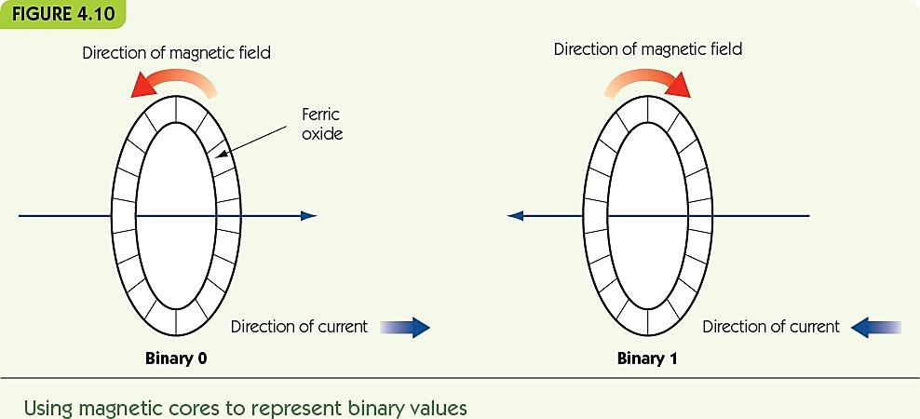
The Binary Numbering System (19 of 21)
Computers use binary because “bistable” systems are reliable
Current on/off
Magnetic field left/right

Slide 24
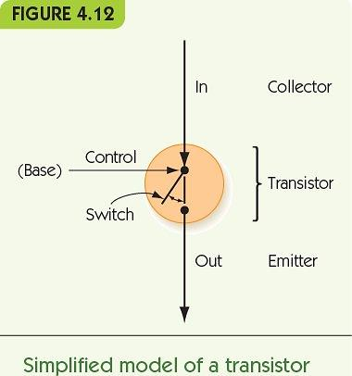
The Binary Numbering System (20 of 21)
Transistors
Solid-state switches
Change on/off when given power on control line
Extremely small (billions per chip)
Enable computers that work with gigabytes of data

Slide 25
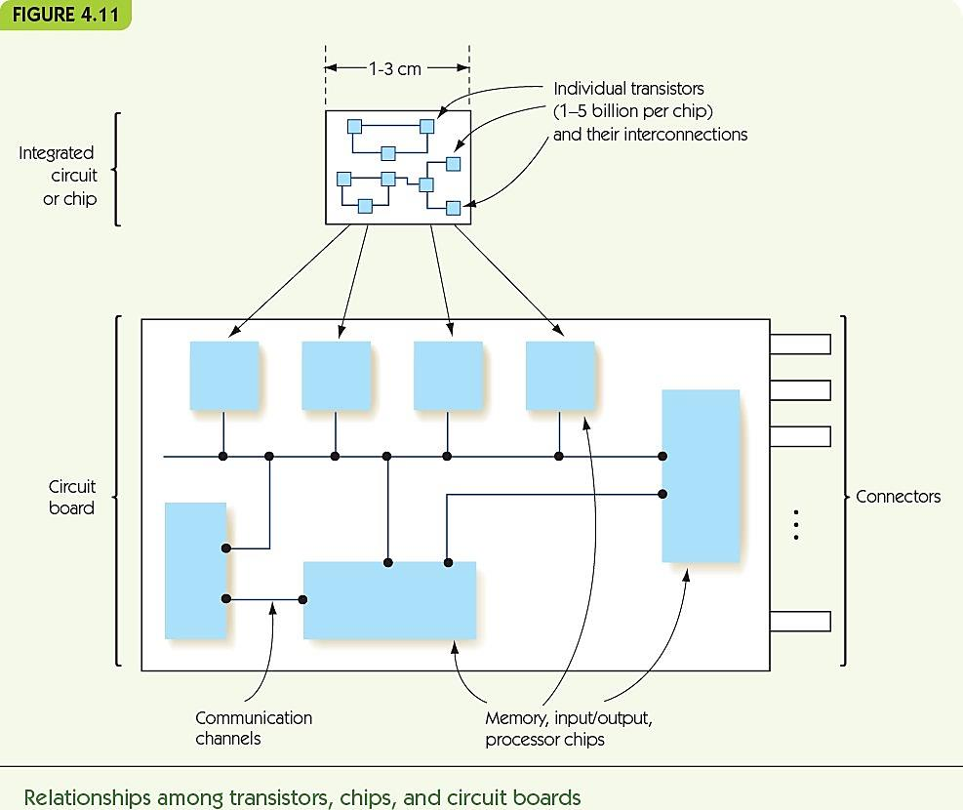
The Binary Numbering System (21 of 21)

Slide 26
Boolean Logic and Gates (1 of 9)
Boolean logic is the rule for manipulating true/false expressions for binary machine language
Boolean expressions can be converted to circuits
Hardware design/logic design pertains to the design and construction of new circuits
Binary 1/0 maps to true/false of Boolean logic
Boolean expressions: x ≤ 35, a = 12
Boolean operators: (0 ≤ x) AND (x ≤ 35), (a = 12) OR (a = 13), NOT (a = 12)
(0 ≤ x) • (x ≤ 35), (a = 12) + (a = 13), ~(a = 12)

Slide 27
Boolean Logic and Gates (2 of 9)
Truth tables lay out true/false values for Boolean expressions, for each possible true/false input

Slide 28
Boolean Logic and Gates (3 of 9)
FIGURE 4.14
Inputs: a | Inputs: b | Output a AND b (also written a . b)
False | False | False
False | True | False
True | False | False
True | True | True
Truth table for the AND operation

Slide 29
Boolean Logic and Gates (4 of 9)
FIGURE 4.15
Inputs: a | Inputs: b | Output a OR b (also written a + b)
False | False | False
False | True | True
True | False | True
True | True | True
Truth table for the OR operation

Slide 30
Boolean Logic and Gates (5 of 9)
FIGURE 4.16
Inputs: a | Output NOT a (also written ā)
False | True
True | False
Truth table for the NOT operation

Slide 31
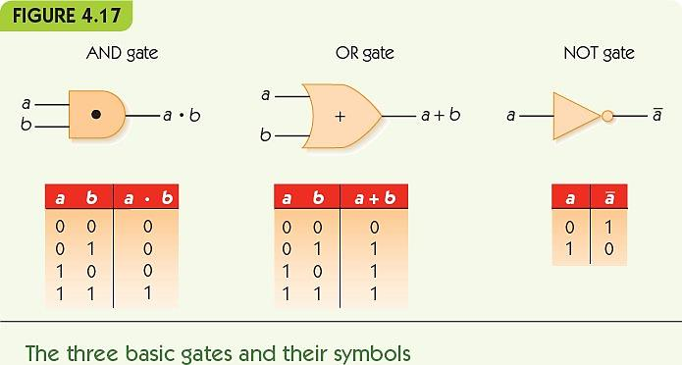
Boolean Logic and Gates (6 of 9)
Gate: an electronic device that operates on inputs to produce outputs
Each gate corresponds to a Boolean operator

Slide 32
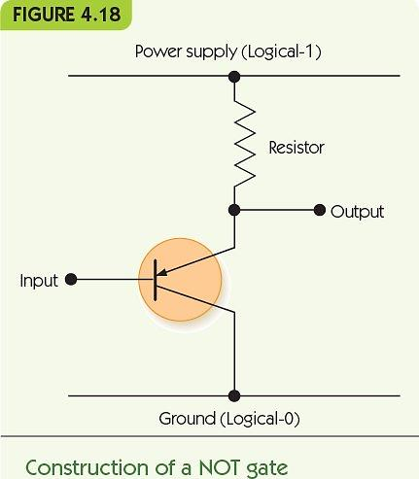
Boolean Logic and Gates (7 of 9)
Gates are built from transistors
NOT gate: 1 transistor
AND gate: 3 transistors
OR gate: 3 transistors
NAND and NOR: 2 transistors
Transistors can be in series or parallel

Slide 33
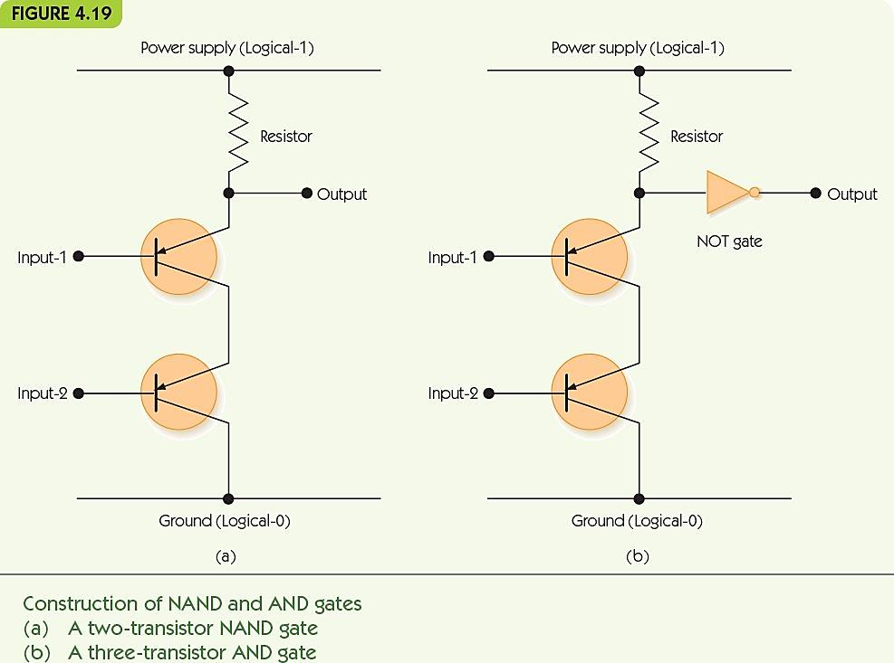
Boolean Logic and Gates (8 of 9)

Slide 34
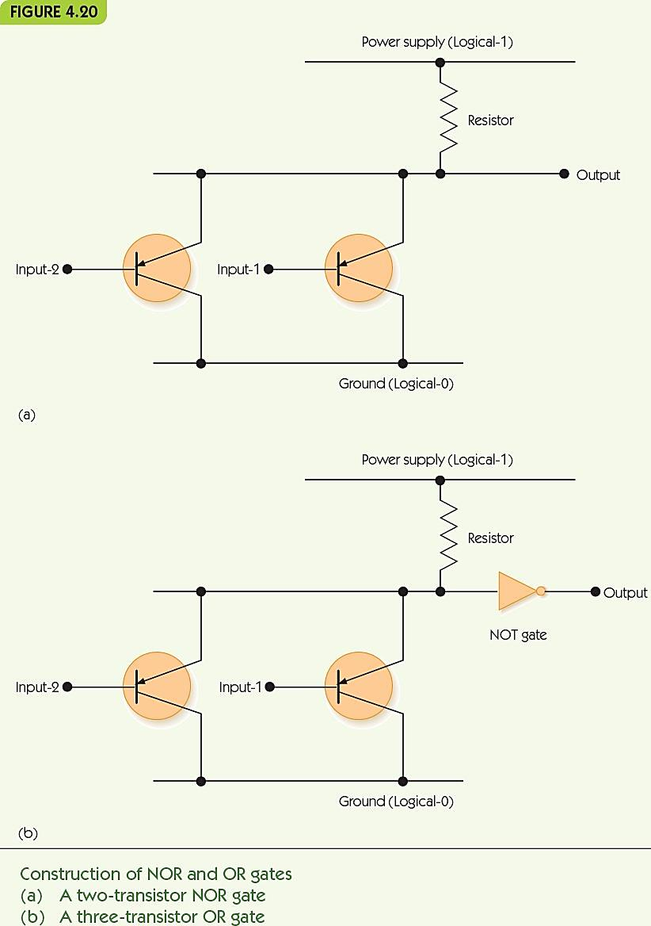
Boolean Logic and Gates (9 of 9)

Slide 35
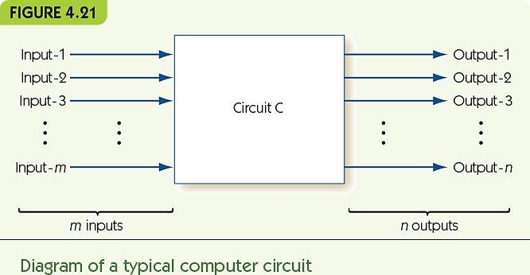
Building Computer Circuits (1 of 18)
Circuit: has input wires, contains gates connected by wires, and has output wires
Outputs depend only on current inputs: no state

Slide 36
Building Computer Circuits (2 of 18)
To convert a circuit to a Boolean expression
Start with output and work backward
Find next gate back, convert to Boolean operator
Repeat for each input, filling in left and/or right side
To convert a Boolean expression to a circuit
Similar approach
To build a circuit from desired outcomes
Use standard circuit construction algorithm
E.g., sum-of-products algorithm

Slide 37
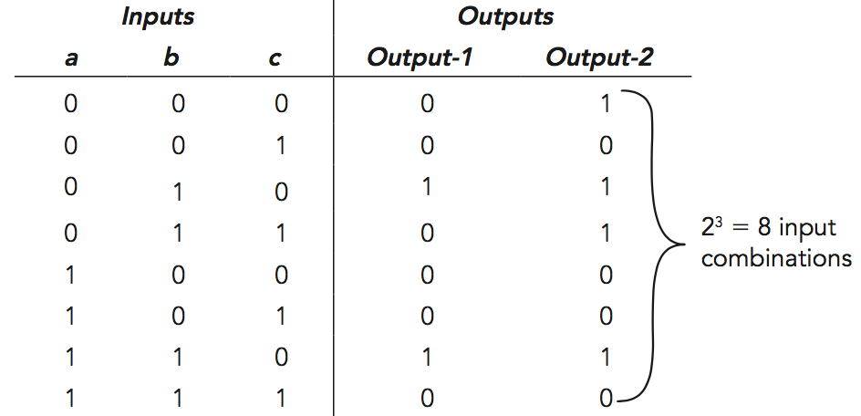
Building Computer Circuits (3 of 18)
Example from text
Build truth table

Slide 38
Building Computer Circuits (4 of 18)
Example from text
Find true rows for Output-1

Slide 39
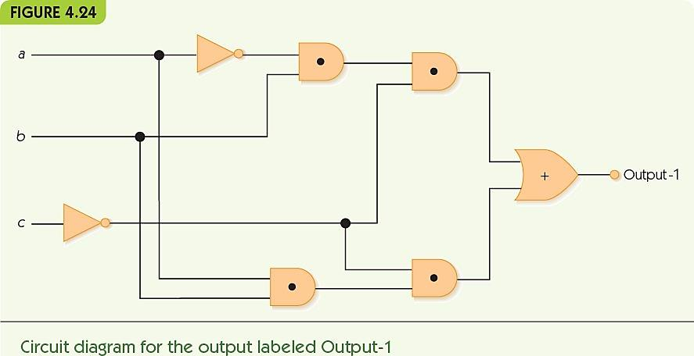
Building Computer Circuits (5 of 18)

Slide 40
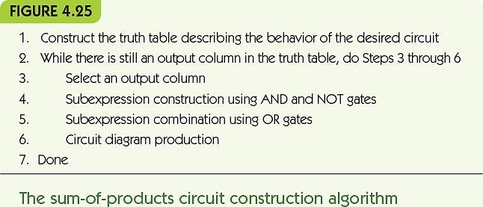
Building Computer Circuits (6 of 18)

Slide 41
Building Computer Circuits (7 of 18)
Compare-for-equality (CE) circuit
Input is two unsigned binary numbers.
Output is 1 if inputs are identical and 0 otherwise.
Start with 1-bit version (1-CE) and build general version from that.

Slide 42
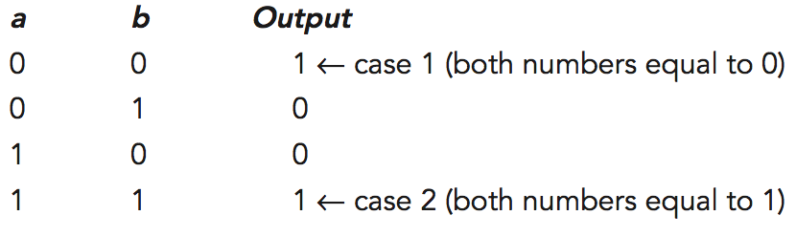
Building Computer Circuits (8 of 18)
1-CE circuit: compare two input bits for equality
Truth table
Boolean expression: (a • b) + (~a • ~b)

Slide 43
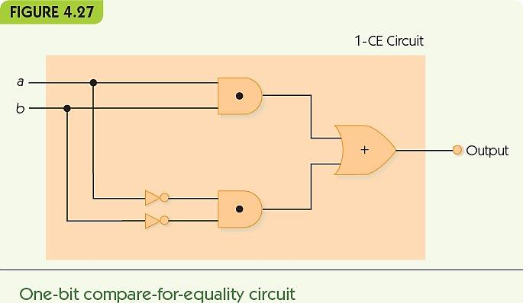
Building Computer Circuits (9 of 18)

Slide 44
Building Computer Circuits (10 of 18)
N-bit CE circuit
Input: a₀a₂…a_{n-1} and b₀b₂…b_{n-1}, where a_{i} and b_{i} are individual bits
Pair up corresponding bits: a₀ with b₀, a₁ with b₁, etc.
Run a 1-CE circuit on each pair
AND the results

Slide 45
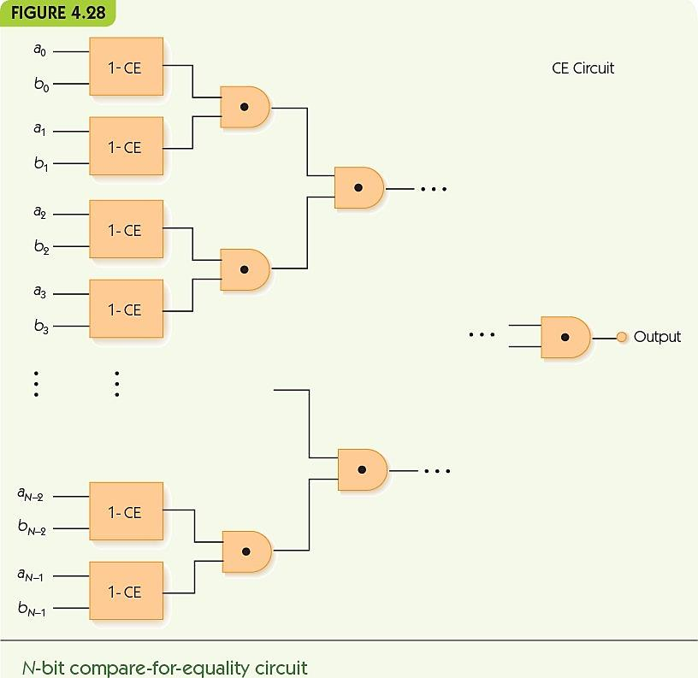
Building Computer Circuits (11 of 18)

Slide 46
Building Computer Circuits (12 of 18)
Full adder circuit
Input is two unsigned N-bit numbers
Output is one unsigned N-bit number, the result of adding inputs together
Example
 |  |  |  | 1
 | 0 | 0 | 1 | 0 | 1
+ | 0 | 1 | 0 | 0 | 1
 | 0 | 1 | 1 | 1 | 0
Start with 1-bit adder (1-ADD)

Slide 47
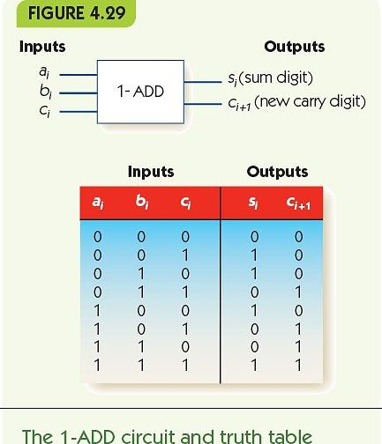
Building Computer Circuits (13 of 18)

Slide 48
Building Computer Circuits (14 of 18)
Sum digit, s_{i}, has the Boolean expression
(~a_{i} • ~b_{i} • c_{i}) + (~a_{i} • b_{i} • ~c_{i}) +
(a_{i} • ~b_{i} • ~c_{i}) + (a_{i} • b_{i} • c_{i})
Carry digit, c_{i+1}, has the Boolean expression
(~a_{i} • b_{i} • c_{i}) + (a_{i} • ~b_{i} • c_{i}) +
(a_{i} • b_{i} • ~c_{i}) + (a_{i} • b_{i} • c_{i})

Slide 49
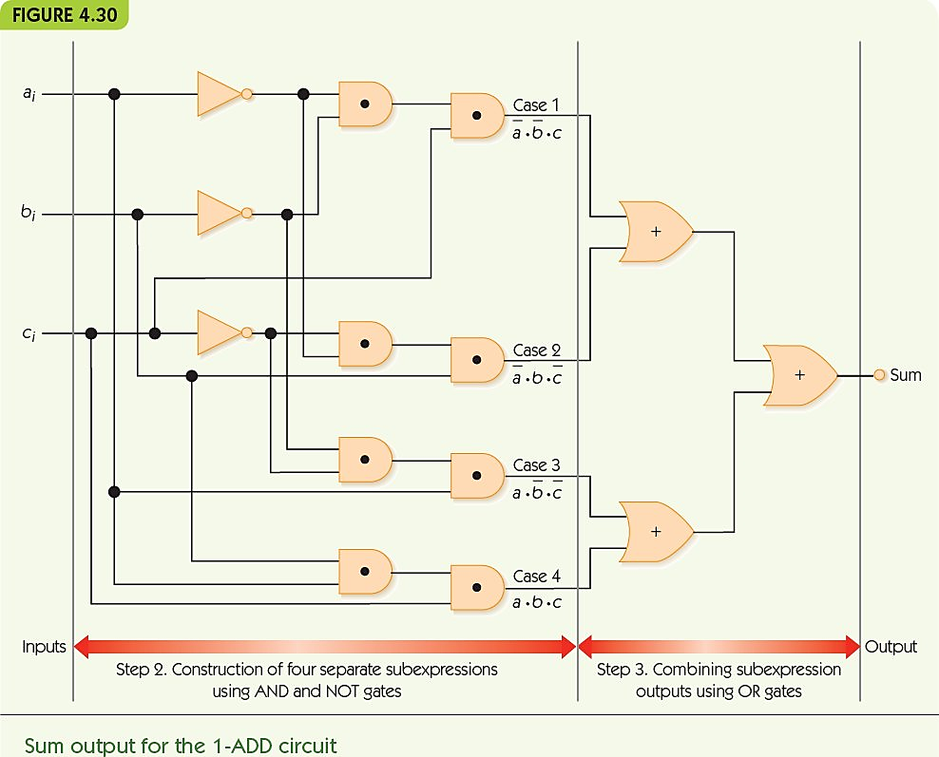
Building Computer Circuits (15 of 18)

Slide 50
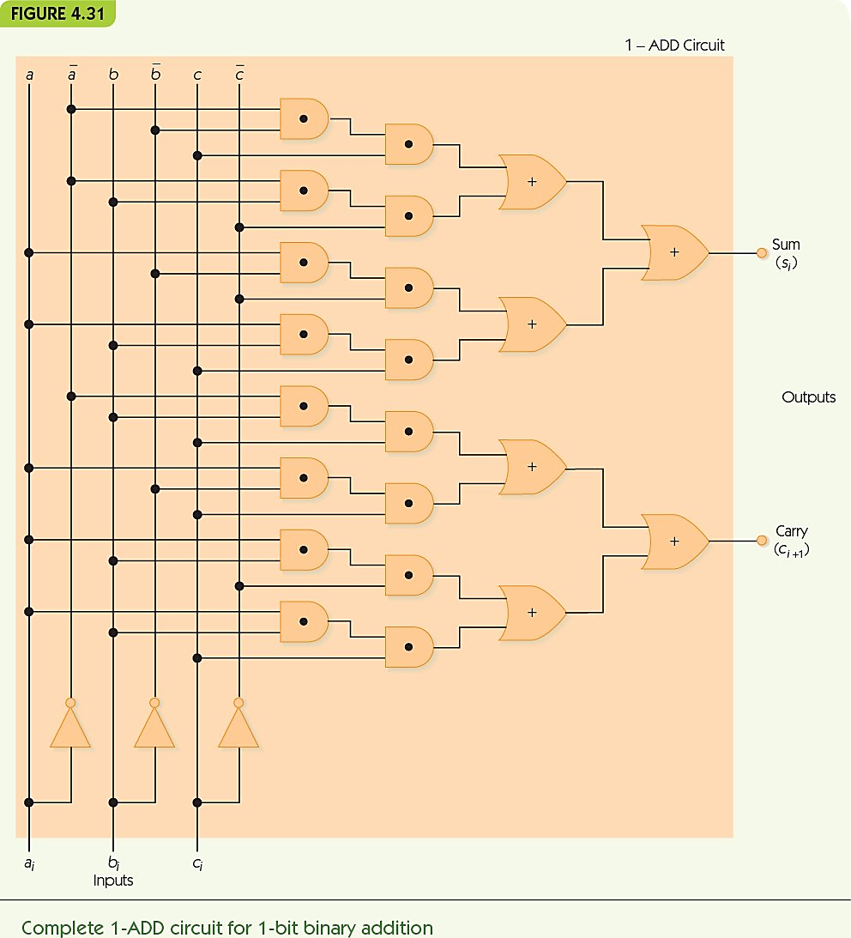
Building Computer Circuits (16 of 18)

Slide 51
Building Computer Circuits (17 of 18)
N-bit adder circuit
Input: a₀a₂…a_{n-1} and b₀b₂…b_{n-1}, where a_{i} and b_{i} are individual bits
a₀ and b₀ are least significant digits: ones place
Pair up corresponding bits: a₀ with b₀, a₁ with b₁, etc.
Run 1-ADD on a₀ and b₀, with fixed carry in c₀ = 0
Feed carry out c₁ to next 1-ADD and repeat

Slide 52
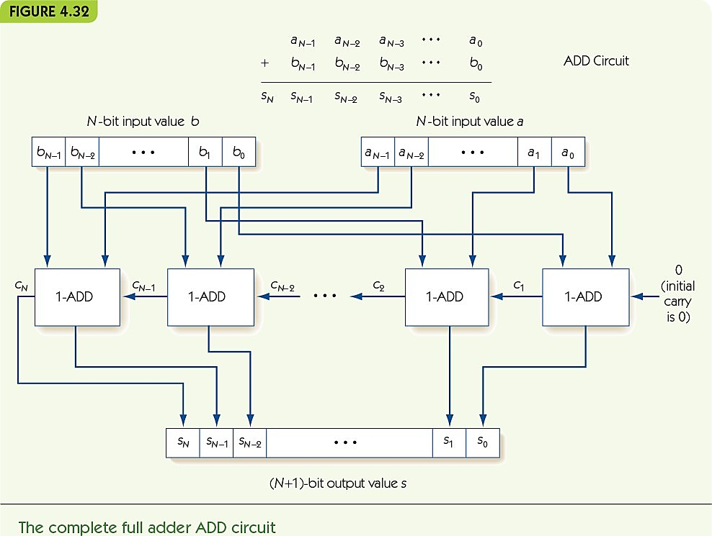
Building Computer Circuits (18 of 18)

Slide 53
Control Circuits (1 of 7)
Control circuits make decisions, determine order of operations, select data values
Multiplexer selects one from among many inputs
2^{N} input lines
N selector lines
1 output line
Each input line corresponds to a unique pattern on selector lines
That input value is passed to output

Slide 54
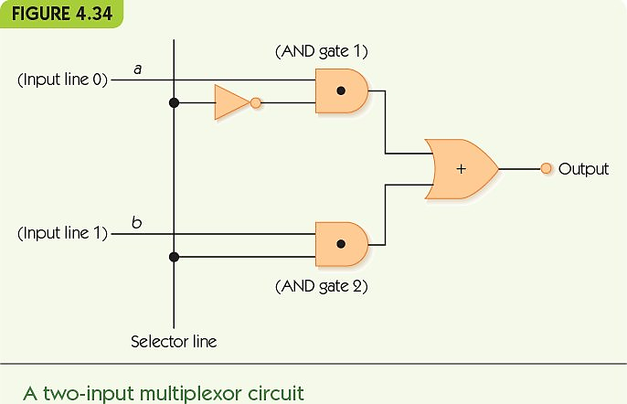
Control Circuits (2 of 7)

Slide 55
Control Circuits (3 of 7)
Decoder sends a signal out to only one output chosen by its input
N input lines
2^{N} output lines
Each output line corresponds to a unique pattern on input lines
Only the chosen output line produces 1, all others output 0

Slide 56
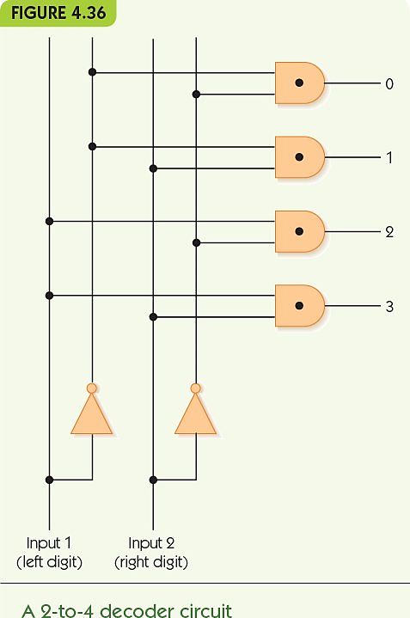
Control Circuits (4 of 7)

Slide 57
Control Circuits (5 of 7)
Decoder circuit uses
To select a single arithmetic instruction, given a code for that instruction
Code activates one output line; that line activates corresponding arithmetic circuit
Multiplexer circuit uses
To choose one data value from among a set, based on selector pattern
Many data values flow into the multiplexer, only the selected one comes out

Slide 58
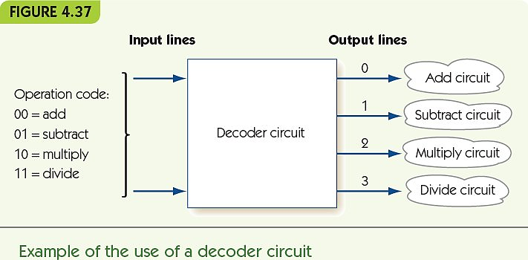
Control Circuits (6 of 7)

Slide 59
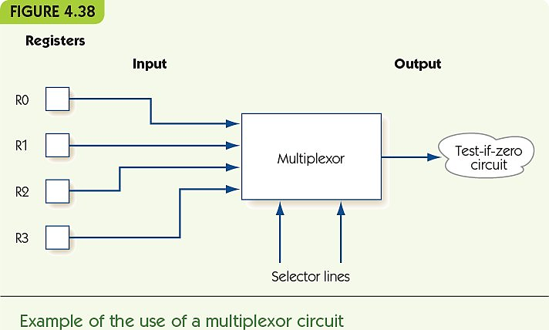
Control Circuits (7 of 7)

Slide 60
Summary (1 of 2)
Computers use binary representations because they maximize reliability for electronic systems.
Many kinds of data may be represented at least in an approximate digital form using binary values.
Data can be compressed.
Lossy: Some information is lost in the process.
Lossless: No information is lost in the process.
Boolean logic describes how to build and manipulate expressions that are true/false.

Slide 61
Summary (2 of 2)
We can build logic gates that act like Boolean operators using transistors
Circuits may be built from logic gates; circuits correspond to Boolean expressions
Sum-of-products is a circuit design algorithm: takes a specification and ends with a circuit
We can build circuits for basic algorithmic tasks
Comparisons (compare-for-equality circuit)
Arithmetic (adder circuit)
Control (multiplexer and decoder circuits)

